Slide 1
On the Properties of Neural Machine Translation: Encoder–Decoder Approaches
- Dzmitry Bahdanau, KyungHyun Cho, Bart van Merrienboer, Yoshua Bengio (2014)
https://aclanthology.org/W14-4012
Harshvivek Kashid
M.Tech.(TA), Sem-II
Advisor: Dr. Pushpak Bhattacharyya
28th January, 2024

Slide 2
Problem Statement
Task: Neural Machine Translation using Encoder-Decoder.
Input: Source sentence in tokenized form, E = <e1, e2, e3, …, em>​
Output: Target sentence in tokenized form, F = <f1, f2, f3, …, fn>​
Given the source text, E, the goal is to predict the target text F, where E and F are text in different languages (English and French).

Slide 3
Motivation
The encoder-decoder architecture forms the backbone of most Neural Machine Translation models.
On the high level, the encoder processes a variable-length input (source sentence) and builds a fixed-length vector representation and then the decoder generates a variable-length sequence (target sentence).
The authors analyzed the properties of two prominent encoder-decoder architectures, RNN Encoder–Decoder and a newly proposed gated recursive convolutional neural network (grConv).
The authors address the limitations in handling long sentences, dealing with unknown words, and capturing complex grammatical structures with the help of these two models.

Slide 4
Literature Review
The author mentions work done in the domain of Machine Translation by, Kalchbrenner and Blunsom, 2013; Cho et al., 2014; Sutskever et al., 2014, where at core of all these works lies an encoder–decoder architecture.
Sutskever et al. (2014) uses an RNN with LSTM units to encode the source sentence and then decodes the target sentence starting from the last hidden state.
Cho et al. (2014) propose using an RNN with gated hidden units to encode and decode a pair of source and target phrases. The author uses the same RNN Encoder-Decoder (RNNenc) as one of the two models analyzed in the paper.

Slide 5
Contribution
The paper offers key contributions to the field of NMT, particularly through its analysis and comparison of RNN and grConv encoder-decoder architectures:
Analysis of Sentence Length and Unknown Words: Authors demonstrate the limitations of RNN in longer sentences and unfamiliar vocabulary situations.
grConv's Potential for Grammatical Structure Learning: This stands in contrast to RNN, which primarily focuses on long-range dependencies but lacks explicit mechanisms for capturing grammatical information.
Efficient and Resource-Aware NMT: The paper also demonstrates grConv's computational efficiency and memory usage advantages compared to other MT systems (500MB NMT vs 10GB SMT)

Slide 6
Dataset
The dataset used was the bilingual parallel corpora provided by ACL WMT '14.
WMT ‘14 contains the following English-French parallel corpora:
Europarl (61M words), news commentary (5.5M), UN (421M), two crawled corpora of 90M and 272.5M words respectively.
The corpora was reduced to 348M words using the data selection method by Axelrod et al. (2011).
For validation, news-test-2012 and news-test-2013 were used, and for testing news-test-2014 from WMT ‘14 was used.
Among all the sentence pairs in the prepared parallel corpus, for reasons of computational efficiency only the pairs where both English and French sentences are at most 30 words long were used for training the NN.
Only the 30,000 most frequent words for both English and French were used. All the other rare words are considered unknown and are mapped to a special token ([UNK]).

Slide 7
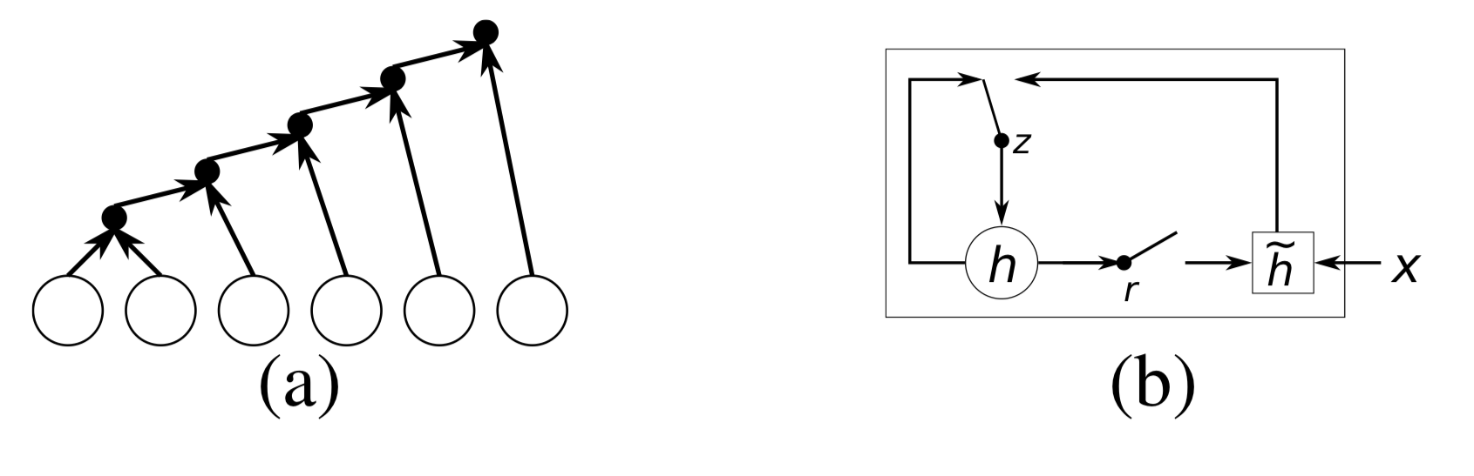
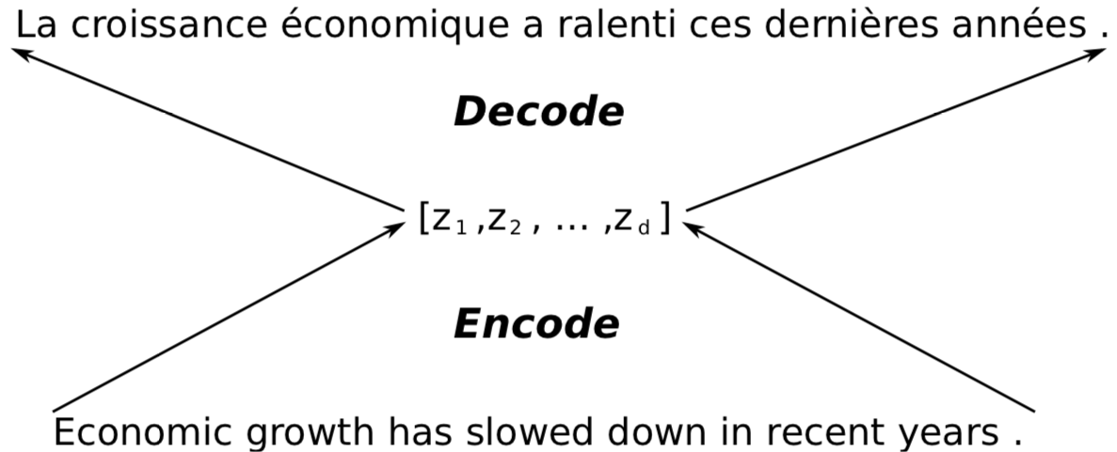
Technique [1/2]
The author explains two Encoder-Decoder based approaches for the NMT task.
Models mentioned in the paper are:
1) The RNN Encoder–Decoder (RNNenc).
2) Gated recursive convolutional neural network (grConv).
In both models, author used the RNN with gated hidden unit which has two gates: reset and update gate.
Each gate depends on the previous hidden state h_{(t−1)}, and the current input x_{t} controls the flow of information.
The RNNenc was trained using minibatch stochastic gradient descent with AdaDelta and had 1000 hidden neurons.
RNN with Gated Hidden Neurons
Encoder–Decoder Architecture

Slide 8
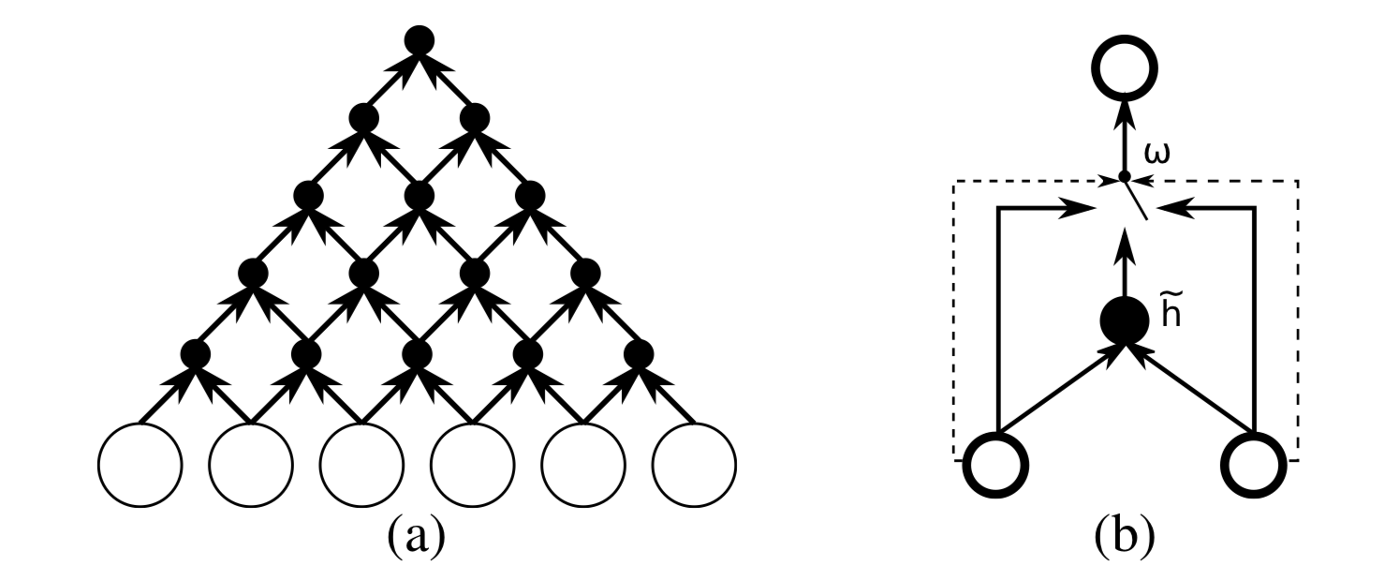
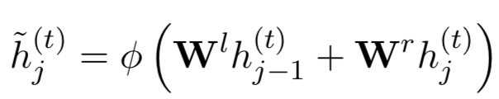
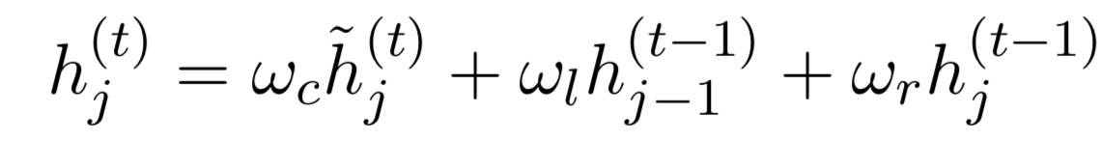
Technique [2/2]
In the grConv model the author introduce a binary convolutional neural network whose weights are recursively applied to the input sequence until it outputs a single fixed length vector.
The grConv encoder used in the paper has 2 convolutional layers with gating mechanisms and each layer produces 1000 feature maps, representing extracted features.
Just like RNNenc, grConv was trained using mini batch stochastic gradient descent with AdaDelta and had 2000 hidden neurons.
Proposed gated unit for the Recursive Convolutional Neural Network
ω - gating coefficients
W - Weight matrix

Slide 9
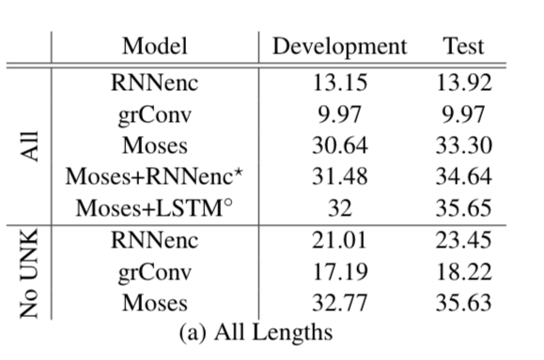
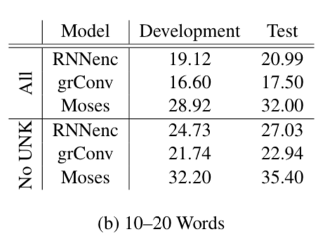
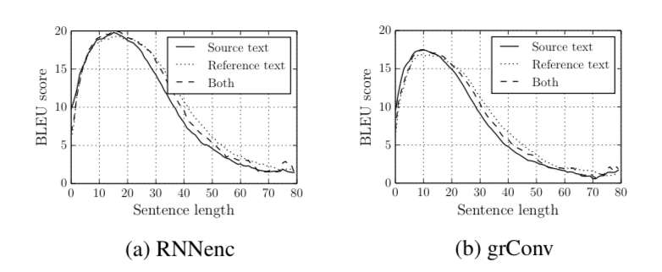
Results
The results here shows the BLEU score obtained by the different models with two cases: Unknown words present, and with no unknown words.
The phrase-based SMT system shows the superior performance over the proposed purely neural machine translation system, but we can see that for No UNK data the difference diminishes quite significantly.
For the sentences with 10 to 20 words and no unknown words, the BLEU scores on the test set are 27.03 and 35.40 for the RNNenc and Moses, respectively.
Notes:
In writing, hedges are words or phrases that express uncertainty.
E.g. It will probably rain today.
“Probably” undercuts the much stronger claim that “it will rain today.” The word “probably” expresses uncertainty about the claim.
Negation is the act of making a term, phrase, or clause negative or opposite.
E.g. Hardly she speaks to me.
In this example, 'hardly' means almost never.

Slide 10
Conclusion
In this paper, the authors proposed RNNenc and grConv models which perform relatively well on short sentences without unknown words, but its performance degrades rapidly as the length of the sentence and the number of unknown words increase.
Despite the lower performance compared to the RNNenc, the grConv model showed the property of learning the grammar structure automatically, thus further research is required on this interesting property.

Slide 11
Future Work
For future work, the authors propose to find a way to scale up training a neural network both in terms of computation and memory so that much larger vocabularies for both source and target languages can be used.
Further, work on improvement is needed to prevent the model from underperforming with long sentences.
While the paper doesn't explicitly describe how grConv learns grammar, it provides evidence suggesting it might be capturing some syntactic information through its unique architecture. More research is needed to fully understand this aspect of grConv and its potential implications for machine translation and language processing.

Slide 12
References
Kyunghyun Cho, Bart van Merriënboer, Dzmitry Bahdanau, and Yoshua Bengio. On the Properties of Neural Machine Translation: Encoder–Decoder Approaches. In Proceedings of SSST-8, Eighth Workshop on Syntax, Semantics and Structure in Statistical Translation, pages 103–111, Doha, Qatar. Association for Computational Linguistics, October, 2014.
Sutskever, Ilya and Vinyals, Oriol and Le, Quoc V, Sequence to Sequence Learning with Neural Networks, Advances in Neural Information Processing Systems 27 (NIPS 2014), Curran Associates, Inc., volume 27, 2014
Nal Kalchbrenner and Phil Blunsom. 2013. Recurrent Continuous Translation Models. In Proceedings of the 2013 Conference on Empirical Methods in Natural Language Processing, pages 1700–1709, Seattle, Washington, USA. Association for Computational Linguistics. October 2013.
C. Gulcehre, O. Firat, K. Xu, K. Cho, L. Barrault, H. Lin, F. Bougares, H. Schwenk, and Y. Bengio, On using monolingual corpora in neural machine translation, in arxiv. June 2015.

